Slide 1
Zenbo Caretaker
Ms. Chidchanok Bunjongpean
Mr. Krittamet Kiattikulwattana
Mr. Teekavu Sucharitakul
Ms. Vipawan Jarukitpipat
Network Computing Laboratory
Professor Chih-Lin Hu
Faculty of Information and Communication Technology
Mahidol University

Slide 2
Introduction

Slide 3
Outline
System Overview
  System design
  Protocol
Development
Testing & Result
Conclusion & Suggestion
Future Plan

Slide 4
Project Detail
Purpose
To reduce the cost of elder care
To fill the gap between the number of available caregivers and the aging population.
To allow users to easily control the home appliances
To enhance better home experience for the users
Group Users
Elderly
Family Members

Slide 5
System Overview
1

Slide 6
Overall system
Caretaker Service
Home Automation
Safety
Services
Behavior Recognition
Control Home Appliances
Environment Sensing
Fall Detection
Smoke & Fire Detection
Module
Routine
Diet
Medicine
Lights
Temperature
Humidity
- Image Processing
-Machine Learning
- Image Recognition
Software
Engineering
- Sync data from wearable
- Raspberry Pi
- Node - RED
- Sensors

Slide 7
System Design

Slide 8
Scope
Home Appliances Controlling System
Zenbo & Android Application
Node - RED & Raspberry Pi

Slide 9
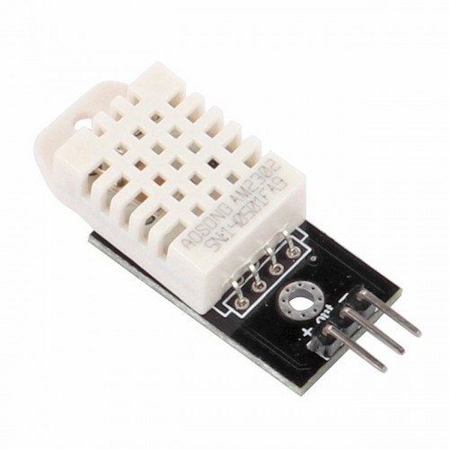
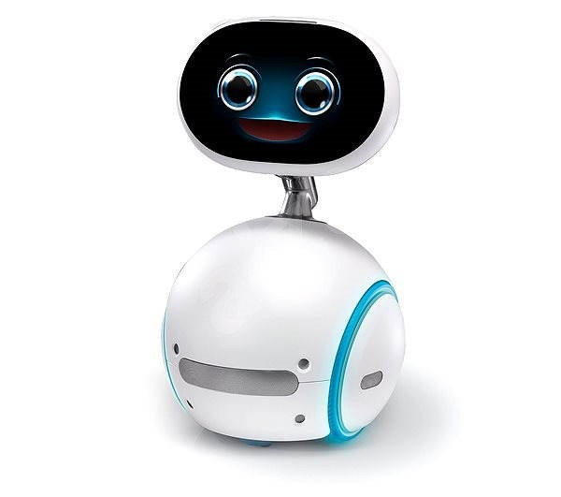
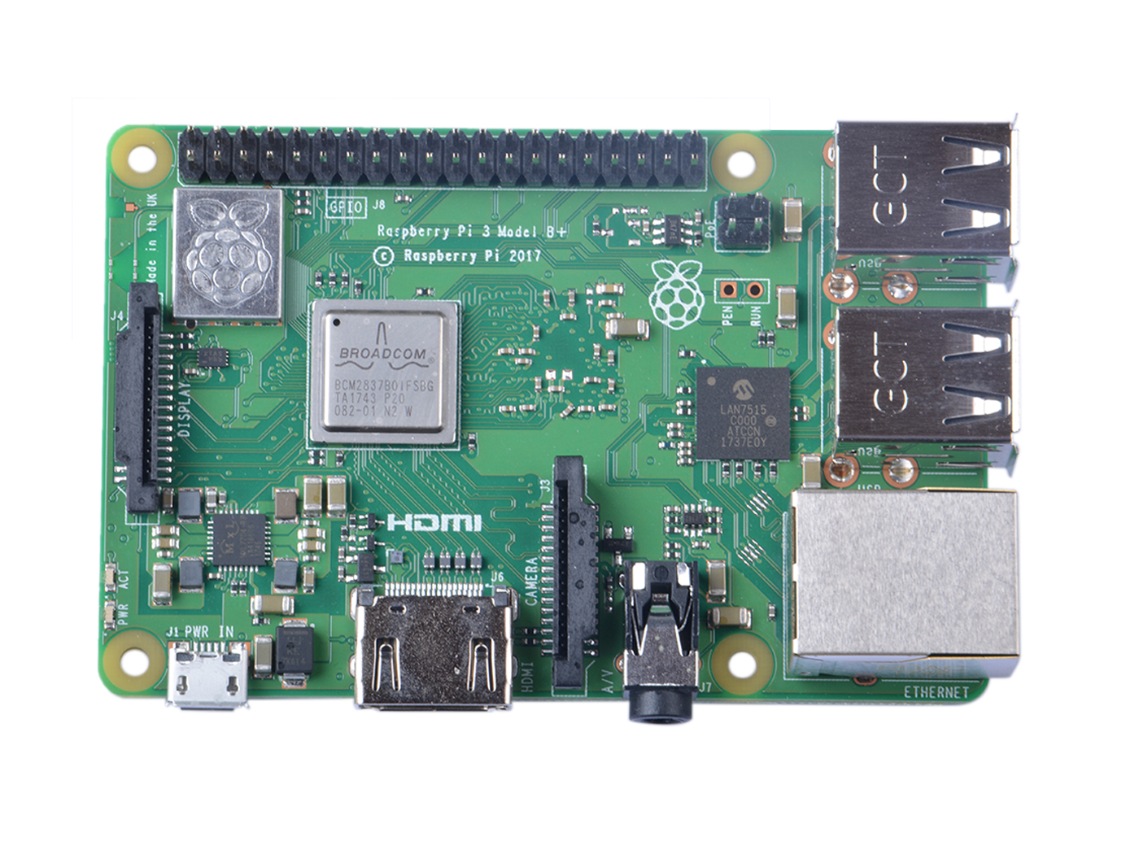
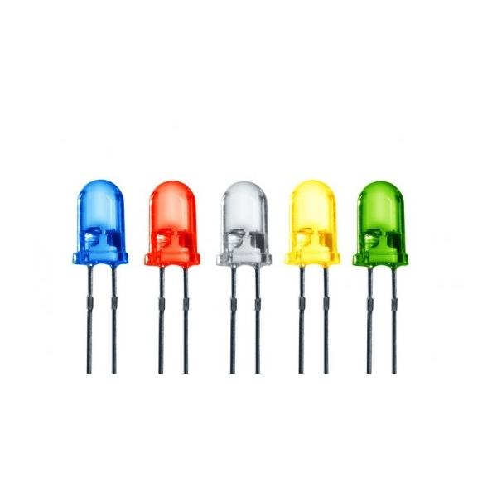
System Flow Overview
1. Detect and display
user command
3. Analyse and classify command
2. Send the command to Node - RED
4. Activate the sensors and obtain data
6. Send the response back to Zenbo
5. Generate the response
7. Display response on the screen

Slide 10








Scenario
Control
Control
Interaction
Update
Control

Slide 11
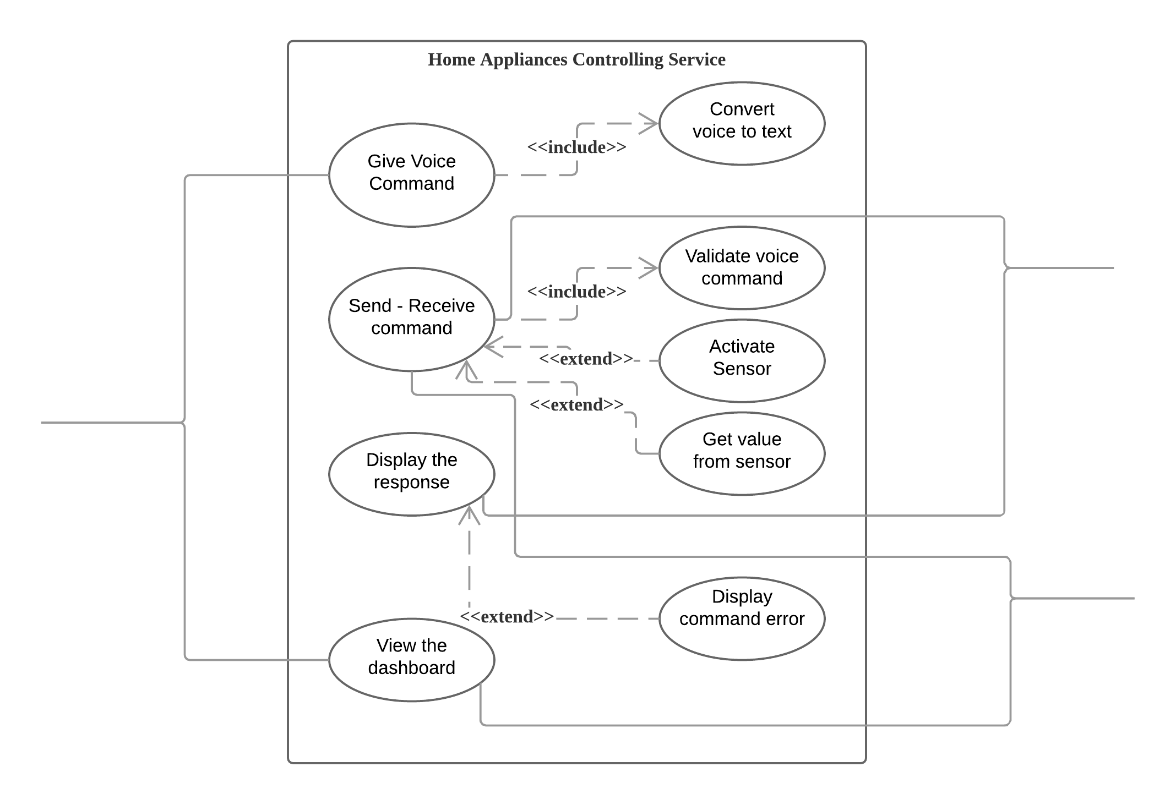

Use Case
Zenbo
Users
Raspberry Pi

Slide 12
Tools
Editor
Programming Language
API
Android Studio
Node - RED
Javascript (Node JS)
Java
Android
Speech Recognition
Zenbo
Zenbo SDK
Library
Android
OKHttp

Slide 13
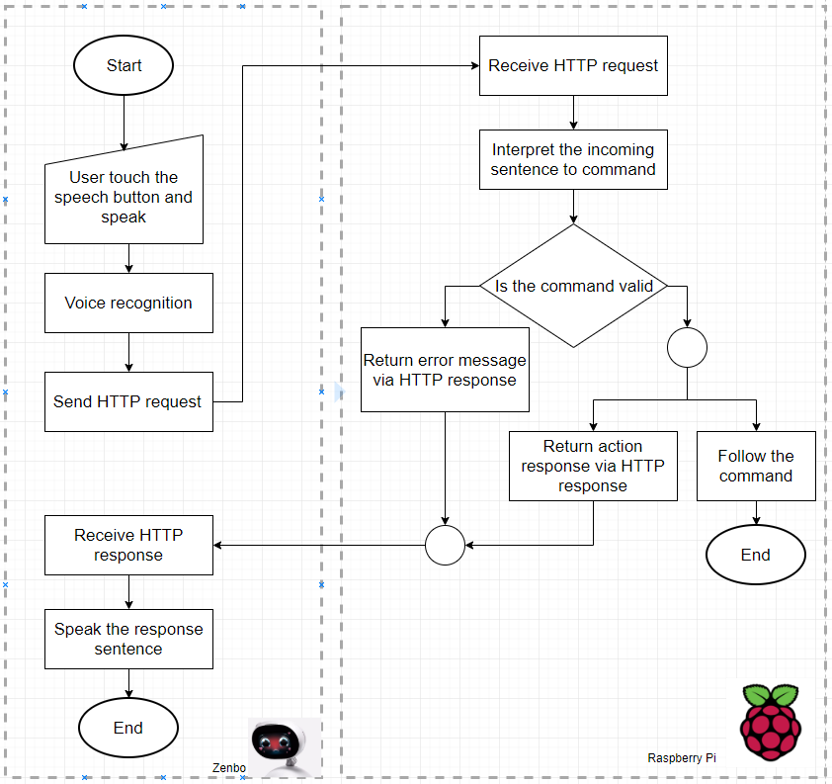
Flow

Slide 14
Protocol

Slide 15
Voice Command Protocol
3 main components
The order doesn’t matter
<Operation> <Room> <Sensor’s name / Appliances>
Turn on Bedroom Tesla
Turn on Bedroom light

Slide 16
Room | Sensor name’s | Appliances | Command
Bedroom | Tesla | Light | Turn on Bedroom Light Turn on Bedroom Tesla
 |  |  | Turn off Bedroom Light Turn off Bedroom Tesla
 | Elsa | Air Conditioner | Turn on Bedroom Air Conditioner Turn on Bedroom Elsa
 |  |  | Switch Bedroom Air Conditioner to dry/cool mode Switch Bedroom Elsa to dry/cool mode
 |  |  | Increase / Decrease Bedroom Air Conditioner Temperature Increase / Decrease Bedroom Elsa Temperature

Slide 17
Room | Sensor name’s | Appliances | Command
Bedroom | Gray | Temperature and Humidity Sensor (DHT22) | Bedroom Temperature Sensor Bedroom Temperature Gray
 |  |  | Bedroom Humidity Sensor Bedroom Humidity Gray

Slide 18
Room | Sensor name’s | Appliances | Command
Living room | Tim | Light | Turn on Bedroom Light Turn on Bedroom Tesla
 |  |  | Turn off Bedroom Light Turn off Bedroom Tesla
 | Dan | Television | Turn on Living room Television Turn on Living room Dan
 |  |  | Turn off Living room Television Turn off Living room Dan
 |  |  | Change Living room Television to next channel
 |  |  | Change Living room Television to previous channel

Slide 19
Development
2

Slide 20
Zenbo and Android Application

Slide 21
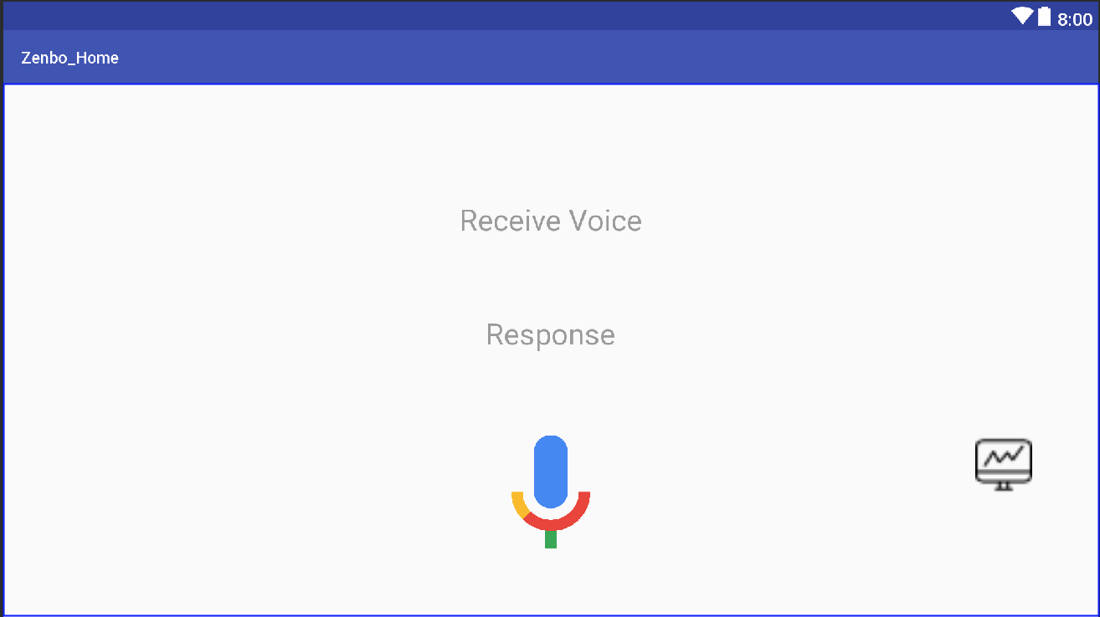

Develop Android Application

Slide 22
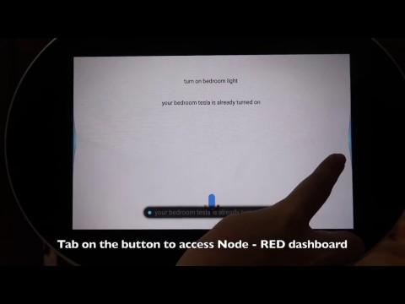
Android Application Demonstration

Slide 23
Testing and Result
3

Slide 24
Test
Zenbo
Zenbo is able to receive voice command
Command successfully sent to Node - RED via Http GET
Application receives and displays the response
The Button is able to use and open Node - RED dashboard on the browser
Raspberry PI
Node - RED receives the command
Node - RED can correctly classify the command and generate response according to command condition
Node - RED can read the data and control the sensors

Slide 25
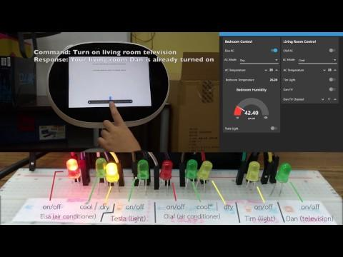
Video Demonstration
Notes:
ใส่ Subtitle
ชี้ใน Clip Video ว่าทำอะไรอยู่
ตอนนี้เราสั่งคำสั่งอะไร
มีทั้งภาพและตัวอักษรอธิบาย

Slide 26
Conclusion and Suggestion
4

Slide 27


Conclusion
Zenbo is able to receive, display voice command and send the text command to Node-RED.
Node-RED is able to receive and interpret the command, update values, and control home appliances.
The voice recognition is not able to detect the correct command when the command is too complex or hard to pronounce which result in invalid command

Slide 28
Future Plan
5

Slide 29
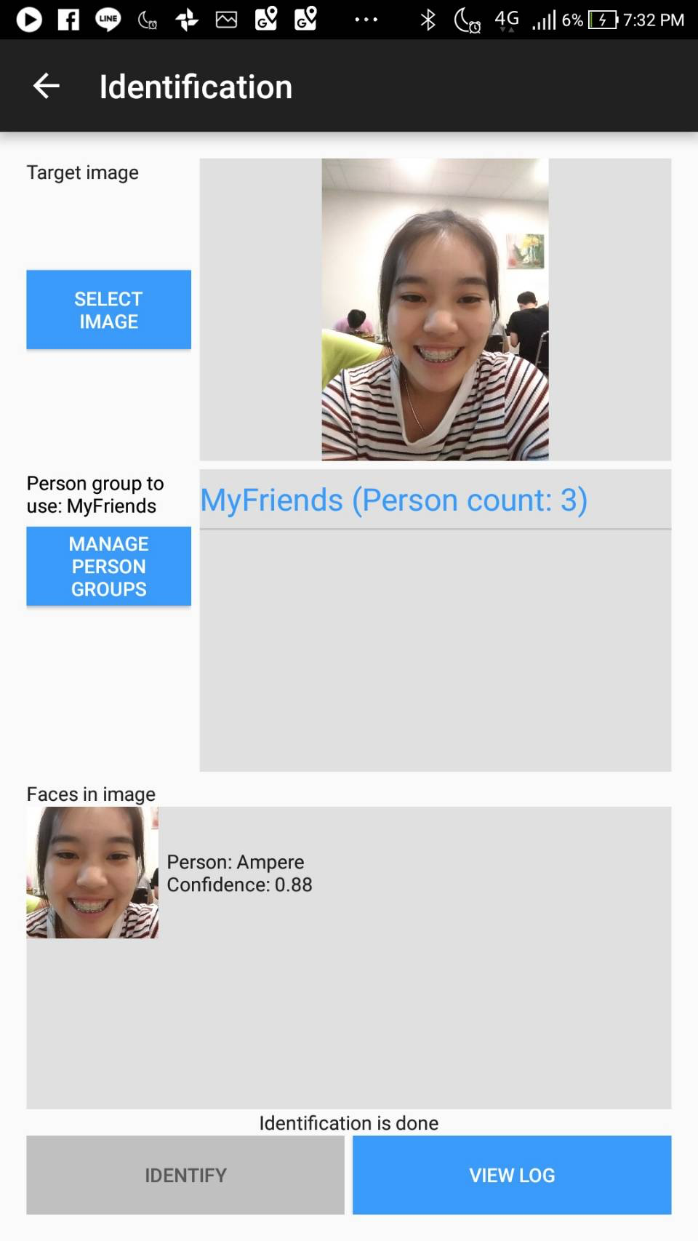
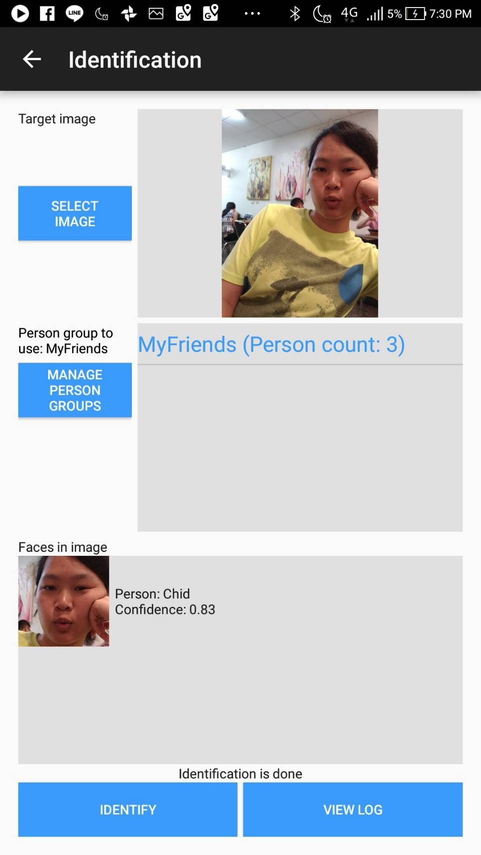
Future Plan
Able to open an application on Zenbo using Voice command
Move the command analysis function from Node - RED to Android application on Zenbo
Integrate Face or Voice recognition system to identify the users
Implement the system that is able to recognize users habits and suggest home configuration preference.
Example of Face Identification using Microsoft Face API
Support other existing IoT devices

Slide 30
Thank you

Slide 31
Q&A
Notes:
Name using device where
Add ห้องที่ไหน
This is only prototype
Use LED light represent home appliances:
อย่าปล่อยให้ Presentation เงียบ

Slide 32
June
 | 1 Jun - 9 Jun | 10 Jun - 16 Jun | 17 Jun - 23 Jun | 24 Jun - 30 Jun
Seminars
RPi installation
RPi Sensors
RPi Camera
IoT Communication Protocol

Slide 33
July
 | 1 Jul - 7 Jul | 8 Jul - 14 Jul | 15 Jul - 21 Jul | 22 Jul - 27 Jul
Research on Zenbo and Node - RED
Node - RED
Android Application
Android Voice Recognition
Android OKHttp
Prepare Presentation

